Slide 1
Stakeholder
Project Title: Meetup app.
Requirements project.

Slide 2
Stakeholder 1
Name: Management Board (Sponsor)
Is a product user (yes/no): no
Stakes/ responsibilities:
Business development decisions (which markets, costs of the project, cost of the product)
Timeline (duration of the project)
Approval required in case of changes for product requirements
Requirements (Approver/ Informed/ n.a.): Approver
Influence factor: High

Slide 3
Stakeholder 2
Name: Customer
Is a product user (yes/no): Yes
Responsibilities:
User needs
Features (report issues,…)
UI definition
Price he or she is willing to pay
Participation in usability evaluation (feedback from the customer)
Requirements (Approver/ Informed/ n.a.): n.a.
Influence factor: High

Slide 4
Stakeholder 3
Name: Developer
Is a product user (yes/no): Yes
Responsibilities:
Communicate timeline
Design product - technical requirements
Understand product requirements
Iterative communication with product and project management
Requirements (Approver/ Informed/ n.a.): Informed
Influence factor: Medium

Slide 5
Stakeholder 4
Name: Stock, shareholders/ Investors
Is a product user (yes/no): No
Responsibilities:
Money to sponsor the project (efforts, scope of the project, timeline)
Requirements (Approver/ Informed/ n.a.): n.a.
Influence factor: Medium

Slide 6
Stakeholder 5
Name: Product owner
Is a product user (yes/no): No
Responsibilities:
Mange overall departments.
Analysis of profit and loss generated by the product.
Report investors.
Requirements (Approver/ Informed/ n.a.): Approver
Influence factor: High

Slide 7
Stakeholder 6
Name: Project manager
Is a product user (yes/no): No
Responsibilities:
Manage team and assign task.
Report Product owner.
Requirements (Approver/ Informed/ n.a.): Informed
Influence factor: Medium

Slide 8
Stakeholder 7
Name: Legal department (data protection)
Is a product user (yes/no): No
Responsibilities:
Suggesting and advising rule and regulations to the product owner.
Surveillance of the activities as per data protection laws.
Requirements (Approver/ Informed/ n.a.): Informed
Influence factor: High

Slide 9
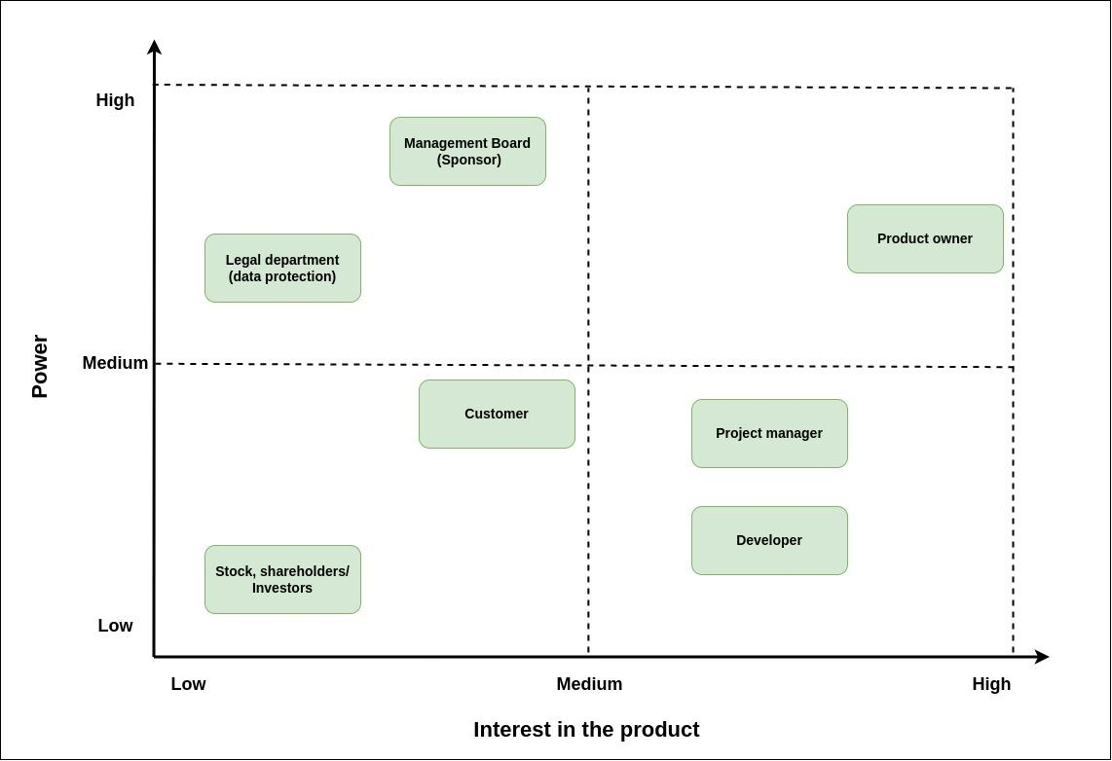
Stakeholder Power Grid

